Slide 1
Customer Segmentation Report
Topic :-
Identify customer segments for online retail with the use of K-means clustering
Date - 29/09/25
by Ishaant Kumar Singh (12203987)

Slide 2
Table of Contents
Business Objective
Methodology (RFM + Clustering)
Segmentation Output
Deep Dive into Customer Segments
Key Insights
Recommendations
Conclusion

Slide 3
Business Objective
Understand customer behavior through purchasing patterns
Segment customers into meaningful groups
Drive personalized marketing & better customer experience
Improve retention & repeat business
For acheving the all the business objectives we are going to apply RFM analysis combined with clustering to identify distinct customer groups and generate business recommendations for customer retention and growth.

Slide 4
Methodology
Work Flow :-
Raw Data → Cleaning → Feature Engineering (RFM) → Scaling → KMeans → Segments → Profiling
Step 1: Data Loading
Imported the transactional dataset (invoices, customers, purchase details).
Used Python libraries (pandas, numpy) for handling structured data.
Step 2: Data Cleaning & Preprocessing
Removed duplicate and canceled transactions (credit notes).
Handled missing values in CustomerID and other key fields.
Filtered only valid sales transactions (positive quantities and amounts).

Slide 5
Step 3: Feature Engineering (RFM Metric Calculation)
Recency (R): Days since the customer’s most recent purchase.
Frequency (F): Total number of purchase transactions.
Monetary (M): Total money spent.
Step 4: Data Normalization
Applied StandardScaler to normalize Recency, Frequency, and Monetary.
Removed scale differences (₹ values vs counts vs days).

Slide 6
Step 5: Clustering (KMeans)
Tested multiple values of k (1–10) using the Elbow Method.
Chose k=4 clusters as optimal balance between cohesion and separation.
Assigned each customer to a cluster based on their RFM profile.
Step 7: Customer Segmentation & Profiling
Aggregated Recency, Frequency, and Monetary by cluster.
Labeled segments:
Clusters 0 --> Active but Low Value Customers
Clusters 1 --> Inactive Customers
Clusters 2 --> VIP Customers
Clusters 3 --> Loyal Customers
Analyzed size, behavior, and business value of each group.

Slide 7
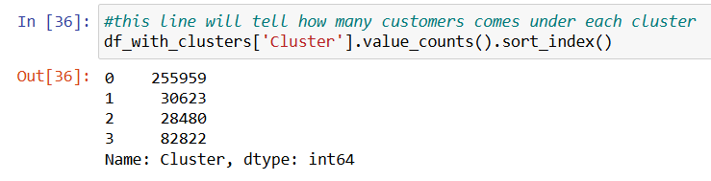
Cluster Distribution
Cluster Sizes:
Cluster 0 → 255959
Cluster 1 → 30623
Cluster 2 → 28480
Cluster 3 → 82822

Slide 8
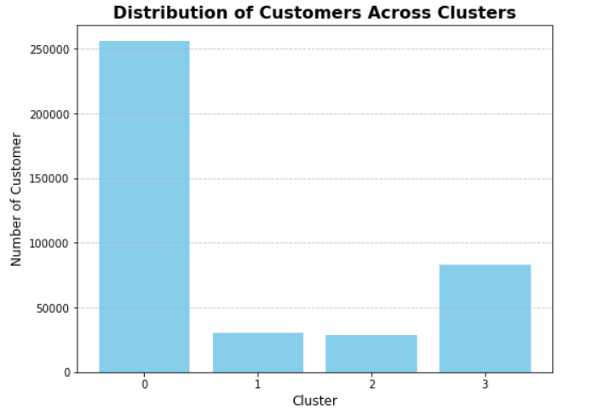
Cluster Visualization Using Bar Plot

Slide 9
Cluster Profiles
$20K
Cluster | Recency | Frequency | Monetary | Customers
0 | 43.7 | 3.68 | 1359 | 255959
1 | 248 | 1.55 | 481 | 30623
2 | 7.38 | 82.5 | 127338 | 28480
3 | 15.5 | 22.3 | 12709 | 82822
10%
45K

Slide 10
Cluster 0 – Regular Shoppers
Cluster Deep Dive
Avg Recency: ~44 days → moderately recent
Avg Frequency: ~3–4 purchases
Avg Spend: ~₹1359
Largest group: 255959 customers (mass market)
Behavior: Active but average-value customers
Business Implication:
Low spend per customer, but large volume = stable revenue base
Can be nudged towards higher frequency and spend
Recommendation:
Personalized product recommendations
Upsell/cross-sell campaigns
Targeted discounts

Slide 11
Cluster 1 – At-Risk Customers
Avg Recency: ~248 days → haven’t purchased in a long time
Avg Frequency: 1.5 purchases → very low
Avg Spend: ~₹481 → very low
30623 customers → significant chunk at risk
Behavior: Once engaged but now largely inactive
Business Implication: Losing them means losing potential future revenue
Recommendation:
Reactivation campaigns (email, SMS)
Limited-time offers to bring them back
“We miss you” personalized outreach

Slide 12
Cluster 2 – VIP Customers
Avg Recency: ~7 days → very recent buyers
Avg Frequency: 82 purchases (!!)
Avg Spend: ~₹127K → extremely high
Very small: only 28480 customers, but outsized contribution
Behavior: Super loyal, high-value customers
Business Implication: Critical to protect this group, they are the top revenue drivers
Recommendation:
White-glove service (priority support, exclusive previews)
Exclusive offers & early access
Personal account manager

Slide 13
Cluster 3 – Loyal Customers
Avg Recency: ~15 days → recent
Avg Frequency: 22 purchases
Avg Spend: ~₹12.7K → high
82822 customers → small but valuable
Behavior: Strong loyalty, consistent spenders
Business Implication: Can help in brand advocacy & referrals
Recommendation:
Loyalty program enrollment
Referral incentives
Keep them engaged with new arrivals

Slide 14
Key Insights
Cluster 2 (VIPs): Tiny group, massive value → must retain
Cluster 3 (Loyalists): Smaller group, consistent contributors → brand advocates
Cluster 0 (Regulars): Big base, stable revenue, growth potential
Cluster 1 (At-Risk): Need reactivation → biggest challenge

Slide 15
Business Recommendations
VIPs → Retain at all costs
Loyal Customers→ Turn into promoters
Regular Shoppers → Upsell + grow spend
At-Risk → Win-back campaigns

Slide 16
Conclusion
RFM-based segmentation uncovered 4 distinct clusters
High-value small groups (VIPs + Loyalists) need retention focus
Large mass (Regulars) = growth opportunity
At-risk customers require re-engagement
Data-driven approach → better customer lifetime value & retention

Slide 17
Thank You

